Slide 1
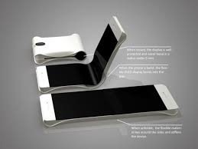
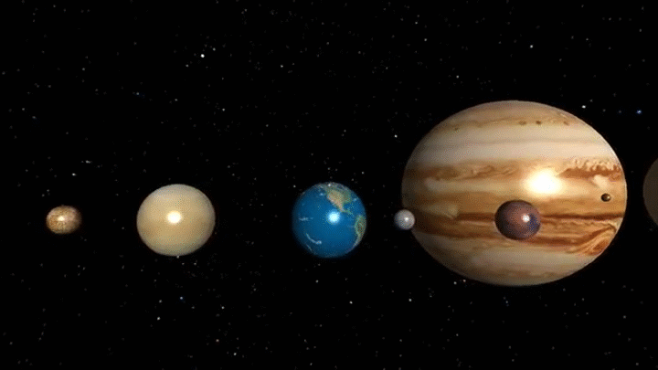
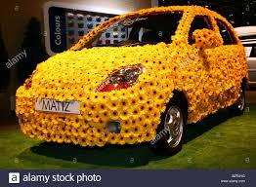
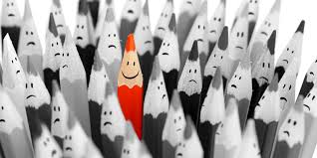
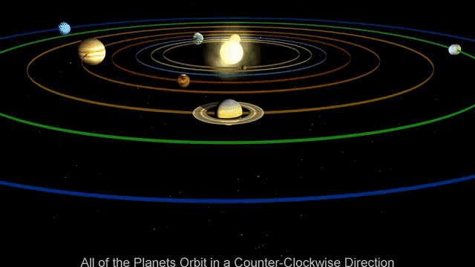
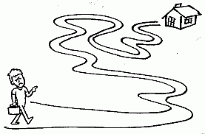
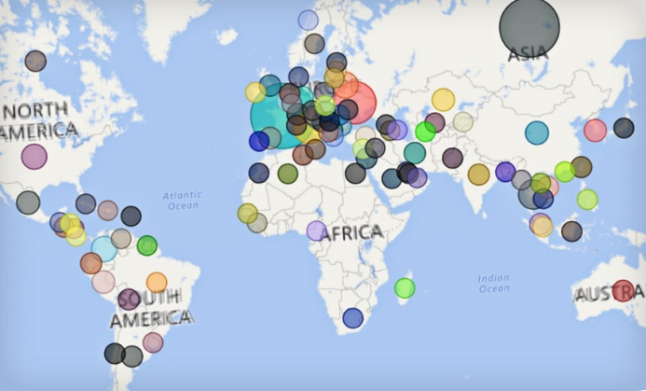
U : 12 P.88-89

Slide 2
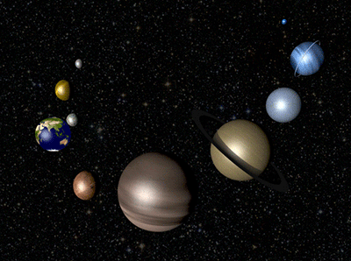
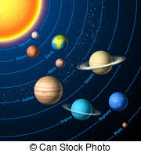
U : 12 P.88-89
universe
( N. )
My dad is the best dad in the universe.

Slide 3
U : 12 P.88-89
entirely
( adv. )
He was entirely tired at the end of the day.

Slide 4
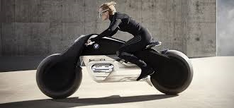
U : 12 P.88-89
advanced
( adj. )
Advanced technology will make our
life easier.

Slide 5
U : 12 P.88-89
notice
(v. )
noticed - noticed

Slide 6
U : 12 P.88-89
I noticed that Ali was too busy.

Slide 7
U : 12 P.88-89
motion
( N. )
The scene was shown in slow motion.

Slide 8
U : 12 P.88-89
widespread
( adj. )
English is a widespread
language.

Slide 9
U : 12 P.88-89
remote
( adj. )
I live in a remote area.

Slide 10
U : 12 P.88-89
remote (adj.)
universe (N.)
notice (V.) noticed
entirely (adv.)
advanced (adj.)
motion (n.)
widespread (adj.)

Slide 11
U : 12 P.88-89

Slide 12
U : 12 P.88-89

Slide 13
U : 12 P.88-89

